Slide 1
Retail Giant Sales Forecasting Assignment
Presented by: Rohan Bhosle

Slide 2
Agenda
Problem Statement
About attributes
Coefficient Of Variance (COV)
Choosing the right technique
Comparing models with MAPE and Result

Slide 3
Problem Statement
Global Mart is an online supergiant store that has worldwide operations
We need to forecast the sales of the products for the next 6 months, so that you have a proper estimate and can plan your inventory and business processes accordingly

Slide 4
About attributes
Attributes | Description
Order-Date | The date on which the order was placed
Segment | The segment to which the product belongs
Market | The market to which the customer belongs
Sales | Total sales value of the transaction
Profit | Profit made on the transaction
Note: Dataset has 21 combinations of ‘Market-Segment’ variables.

Slide 5
Coefficient of Variance (COV)
Sr. no. | MarketSegment | COV
1 | APAC-Consumer | 0.596404
2 | EU-Consumer | 0.647485
3 | LATAM-Consumer | 0.680684
4 | EU-Corporate | 0.689346
5 | APAC-Corporate | 0.731926
6 | LATAM-Corporate | 0.88026
7 | US-Corporate | 1.027209
8 | APAC-Home Office | 1.048817
9 | US-Consumer | 1.095295
10 | EU-Home Office | 1.114681
11 | Canada-Corporate | 1.19722
12 | US-Home Office | 1.217133
13 | LATAM-Home Office | 1.343696
14 | Africa-Consumer | 1.429335
15 | Canada-Consumer | 1.476093
16 | Africa-Corporate | 1.664827
17 | Africa-Home Office | 1.989866
18 | Canada-Home Office | 2.1883
19 | EMEA-Consumer | 2.716992
20 | EMEA-Home Office | 6.066684
21 | EMEA-Corporate | 6.779639
Market segment “APAC-Consumer” is more consistent profitable
Note: Market-Segment ‘APAC-Consumer’ has low value of COV based on Profit data amongst all Market Segments which concludes that it is more consistent profitable. Hence further analysis and modelling will be based on ‘APAC-Consumer’ data.

Slide 6
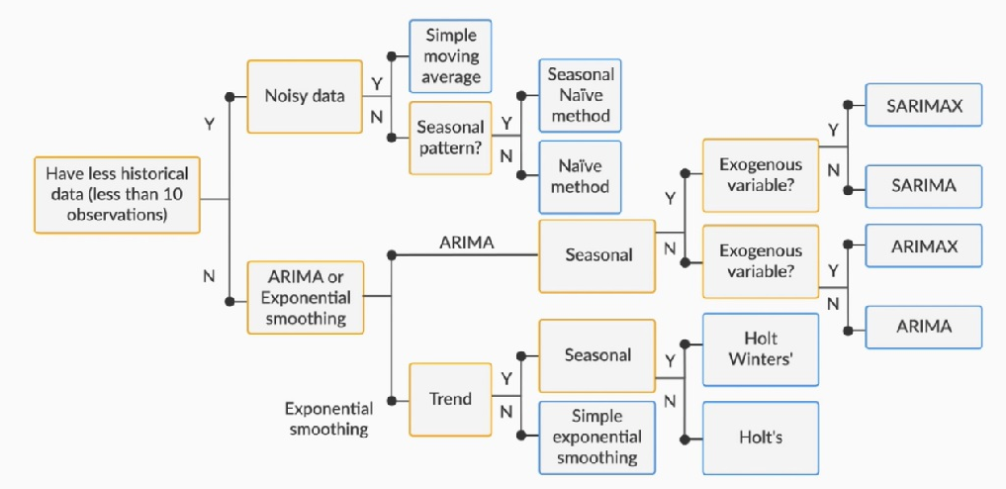
Choosing the right technique
To forecast the data using time series modelling
Note: Our dataset has more than 10 observations, hence we used ‘Exponential Smoothing’ and ‘Auto Regression’ techniques of time series forecasting.

Slide 7
Comparing Models with MAPE and Result
Type | Sr No | Time Series Techniques | MAPE
Exponential Smoothing | 1 | Simple exponential smoothing Method | 27.82
 | 2 | Holt's exponential smoothing Method | 42.57
 | 3 | Holt Winters's additive Method | 17.61
 | 4 | Holt Winters's Multiplicative Method | 19.62
Auto Regressive | 5 | (AR) Auto regression Method | 27.27
 | 6 | (MA) Moving Average Method | 81.64
 | 7 | (ARMA) Autoregressive Moving Average Method | 77.66
 | 8 | (ARIMA) Autoregressive Integrated Moving Average Method | 77.66
 | 9 | (SARIMA) Seasonal Autoregressive Integrated Moving Average Method | 18.38
Result :
We are done with performing all the time series forecasting methods/models on the Retail store data
If we just look at the smoothing techniques, then “Holt Winters's additive” forecast performs better with MAPE value of 17.61
And if we look at the Auto Regressive methods, then “(SARIMA) Seasonal Autoregressive Integrated” method performs better with a MAPE value of 18.38
So, at an overall, looking at the above table of MAPE values for all the forecasting methods, we can clearly see that “Holt Winters's additive’ forecast is clear winner with MAPE value of 17.61
So, we can conclude that, Holt Winters's additive forecast is more accurate amongst all other forecasting methods on this retail store data due to low MAPE value.

Slide 8
Thank You

